Slide 1






16. REVIEW APPLICATION SUMMARY
Please verify all details before final submission. Click "edit" to return to any section.
Edit
Edit
Edit
PERSONAL & CONTACT
FAMILY INFO
ACADEMIC BACKGROUND
Name: John Doe
Status: Married
Last School: Jinja SS
DOB: 15/05/1995
Spouse: Jane Doe
Years Comp: 14
Tel: +256 700 000 000
Children: 3 (Ages 4, 7, 9)
Higher Ed: B.A. Education
Email: applicant@example.com
Edit
Edit
MINISTRY & WORK
FINANCIAL PLAN
ATTACHED DOCUMENTS
Saved Since: 2012
Self Support: 200,000 UGX
Current Church: First Baptist
Church Support: 110,000 UGX
Job: Teacher
Total: 310,000 UGX (Cert/Dip Rate)
Everything looks correct? Proceed to sign and submit.
NEXT: Final Declaration

Slide 2
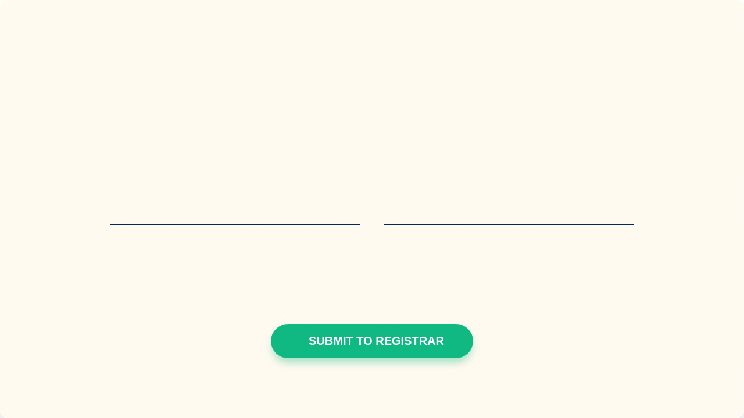

17. FINAL DECLARATION
"I, the undersigned, hereby declare that the information provided is accurate and true to the best of my knowledge. I understand that any false statements may lead to the cancellation of my application or dismissal from Uganda Baptist Seminary."
Type Full Name to Sign
Date of Submission
JOHN DOE
28 / 04 / 2026
Transmission Notice: Your application will be converted to a secure PDF and sent to: b.masaba@ugandabaptistseminary.org • b.masaba256@gmail.com • musicvoicechat@gmail.com

Slide 3


IMAGE SOURCES
x-raw-image:///0e9c7720e0a6782e25e1a3cc02b414d2ddb48c29f669a40404937356ea892e19
Source: ugandabaptistseminary.org
https://ugandabaptistseminary.org/wp-content/uploads/2022/08/cropped-ubs-exterior-2-e1674867889682.jpeg
Source: ugandabaptistseminary.org

